Slide 1



Team Worked
THYNK UNLIMITED.
on this project :
1- Hazem Ahmed Mohamed
2- Ahmed Mohamed Al-badawy
3- Abdel Rahman El-Sherbiny
4- Yousef Fady
5- Mohamed Hatem
Real-Time
Hand Gesture Recognition
Next Slide
PROJECT OVERVIEW

Slide 2
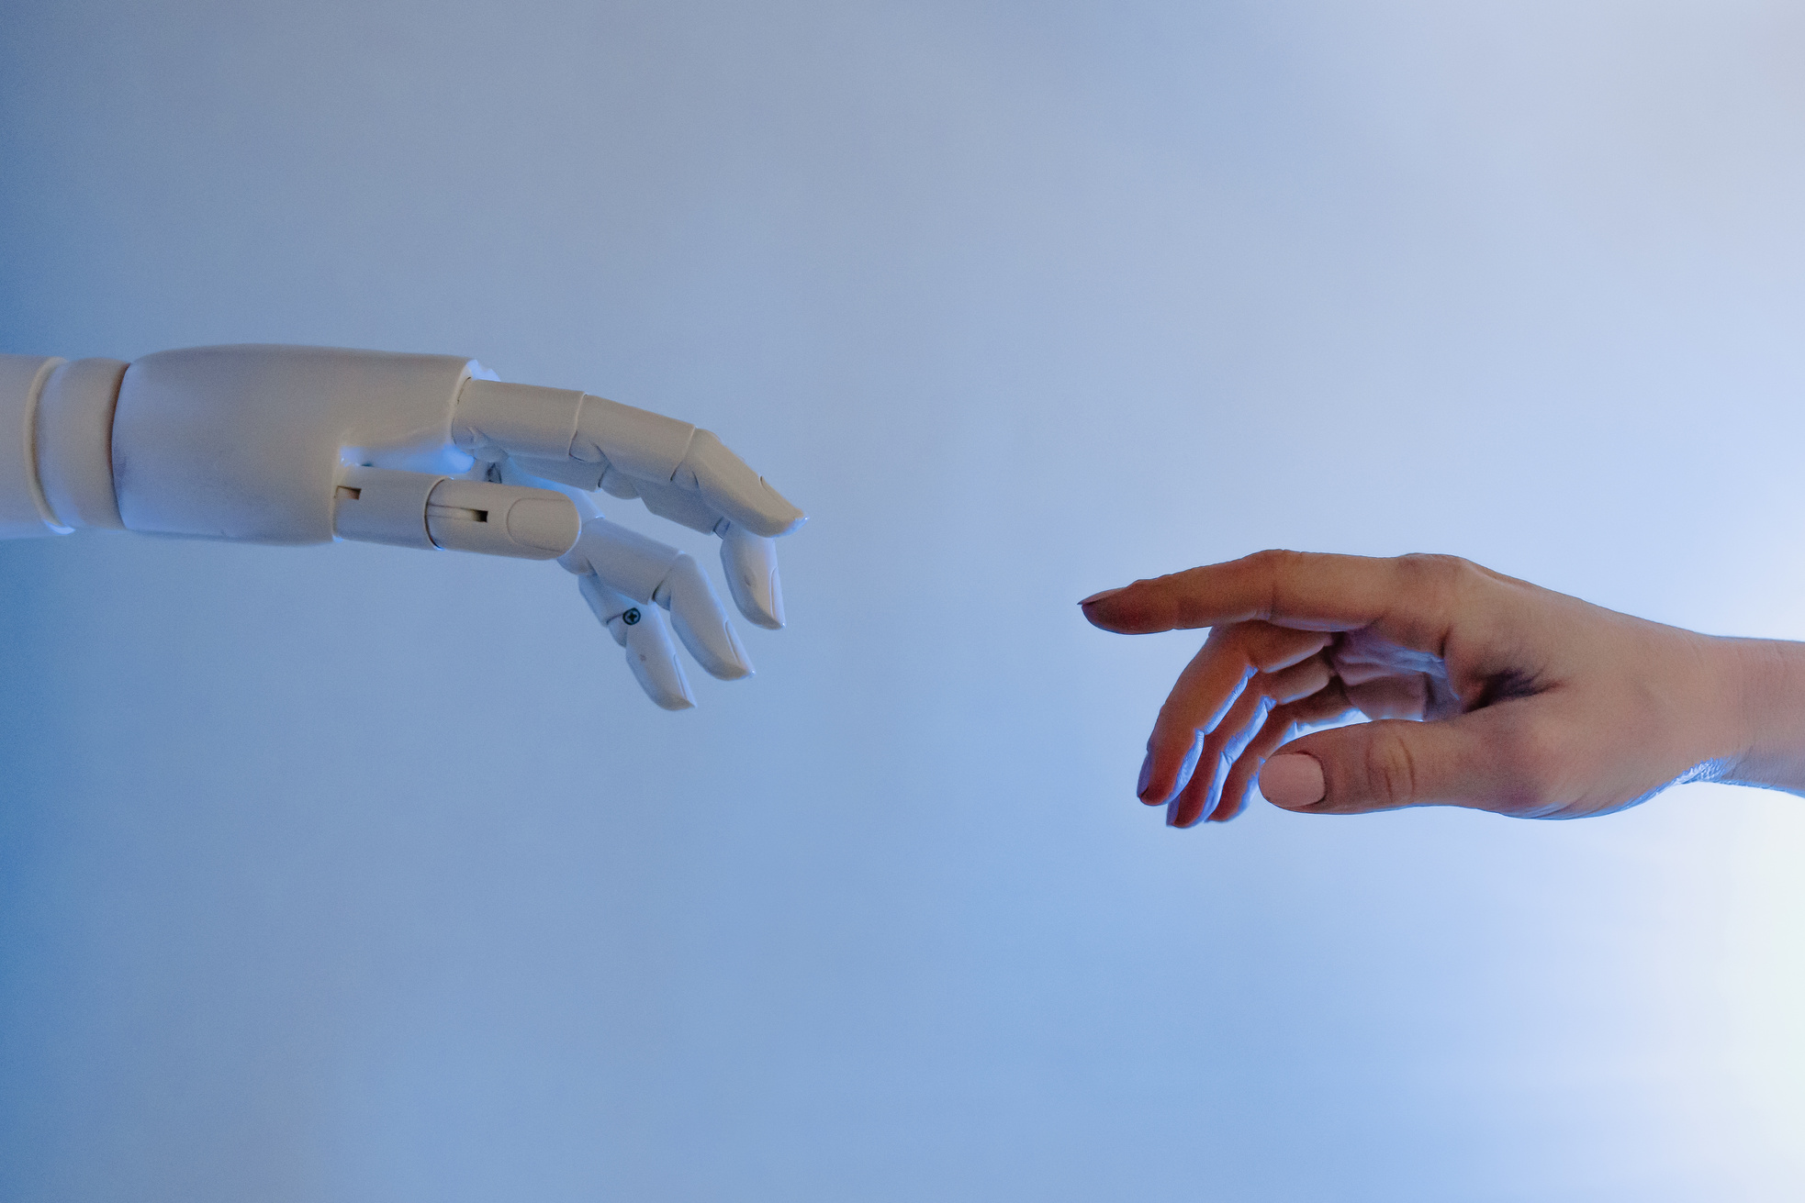
THYNK UNLIMITED.
PROJECT
OVERVIEW
THE PROJECT SHOWCASES THE INTEGRATION OF COMPUTER VISION, DEEP LEARNING, AND REAL-TIME PROCESSING INTO ONE SEAMLESS INTERACTION PIPELINE.
This project develops a real-time system capable of recognizing static hand gestures using a standard webcam.
The system extracts hand landmarks, classifies gestures using a trained deep learning model, and displays predictions instantly enabling intuitive, device-free interaction.

Slide 3
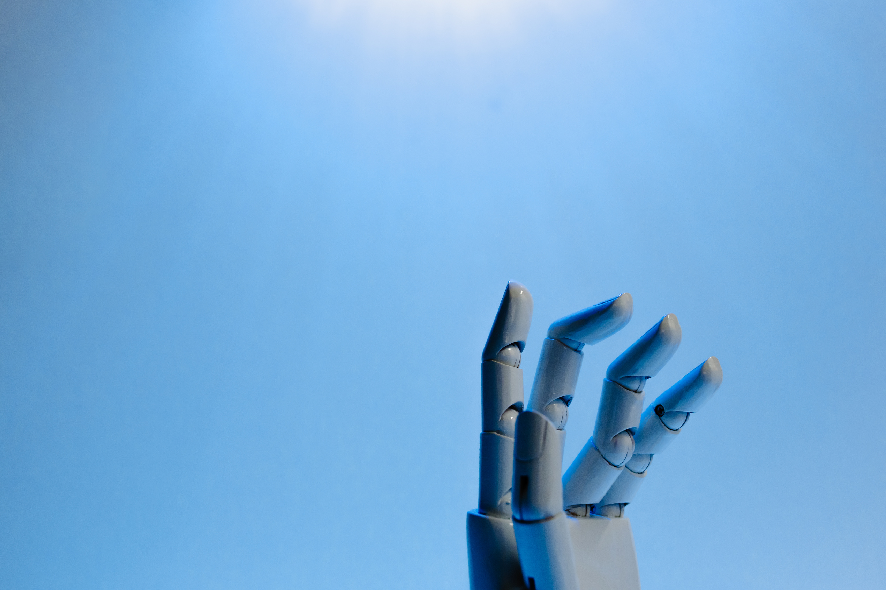
THYNK UNLIMITED.
THE PROBLEM
WE ARE SOLVING
TRADITIONAL INTERFACES RELY HEAVILY ON PHYSICAL DEVICES
Physical input devices limit accessibility, reduce hygiene in shared environments, and restrict hands-free interaction.
There is a strong need for a more natural, effortless way to communicate with computers one that relies only on gestures and simple camera input
Next Slide

Slide 4
THYNK UNLIMITED.
GOALS &
CORE FEATURES
Real-time gesture recognition with minimal latency
High accuracy across multiple gesture classes
User-friendly interface for testing and demos
Lightweight, landmark-based inference for fast processing
Scalable design for future cloud deployment and MLOps integration

Slide 5
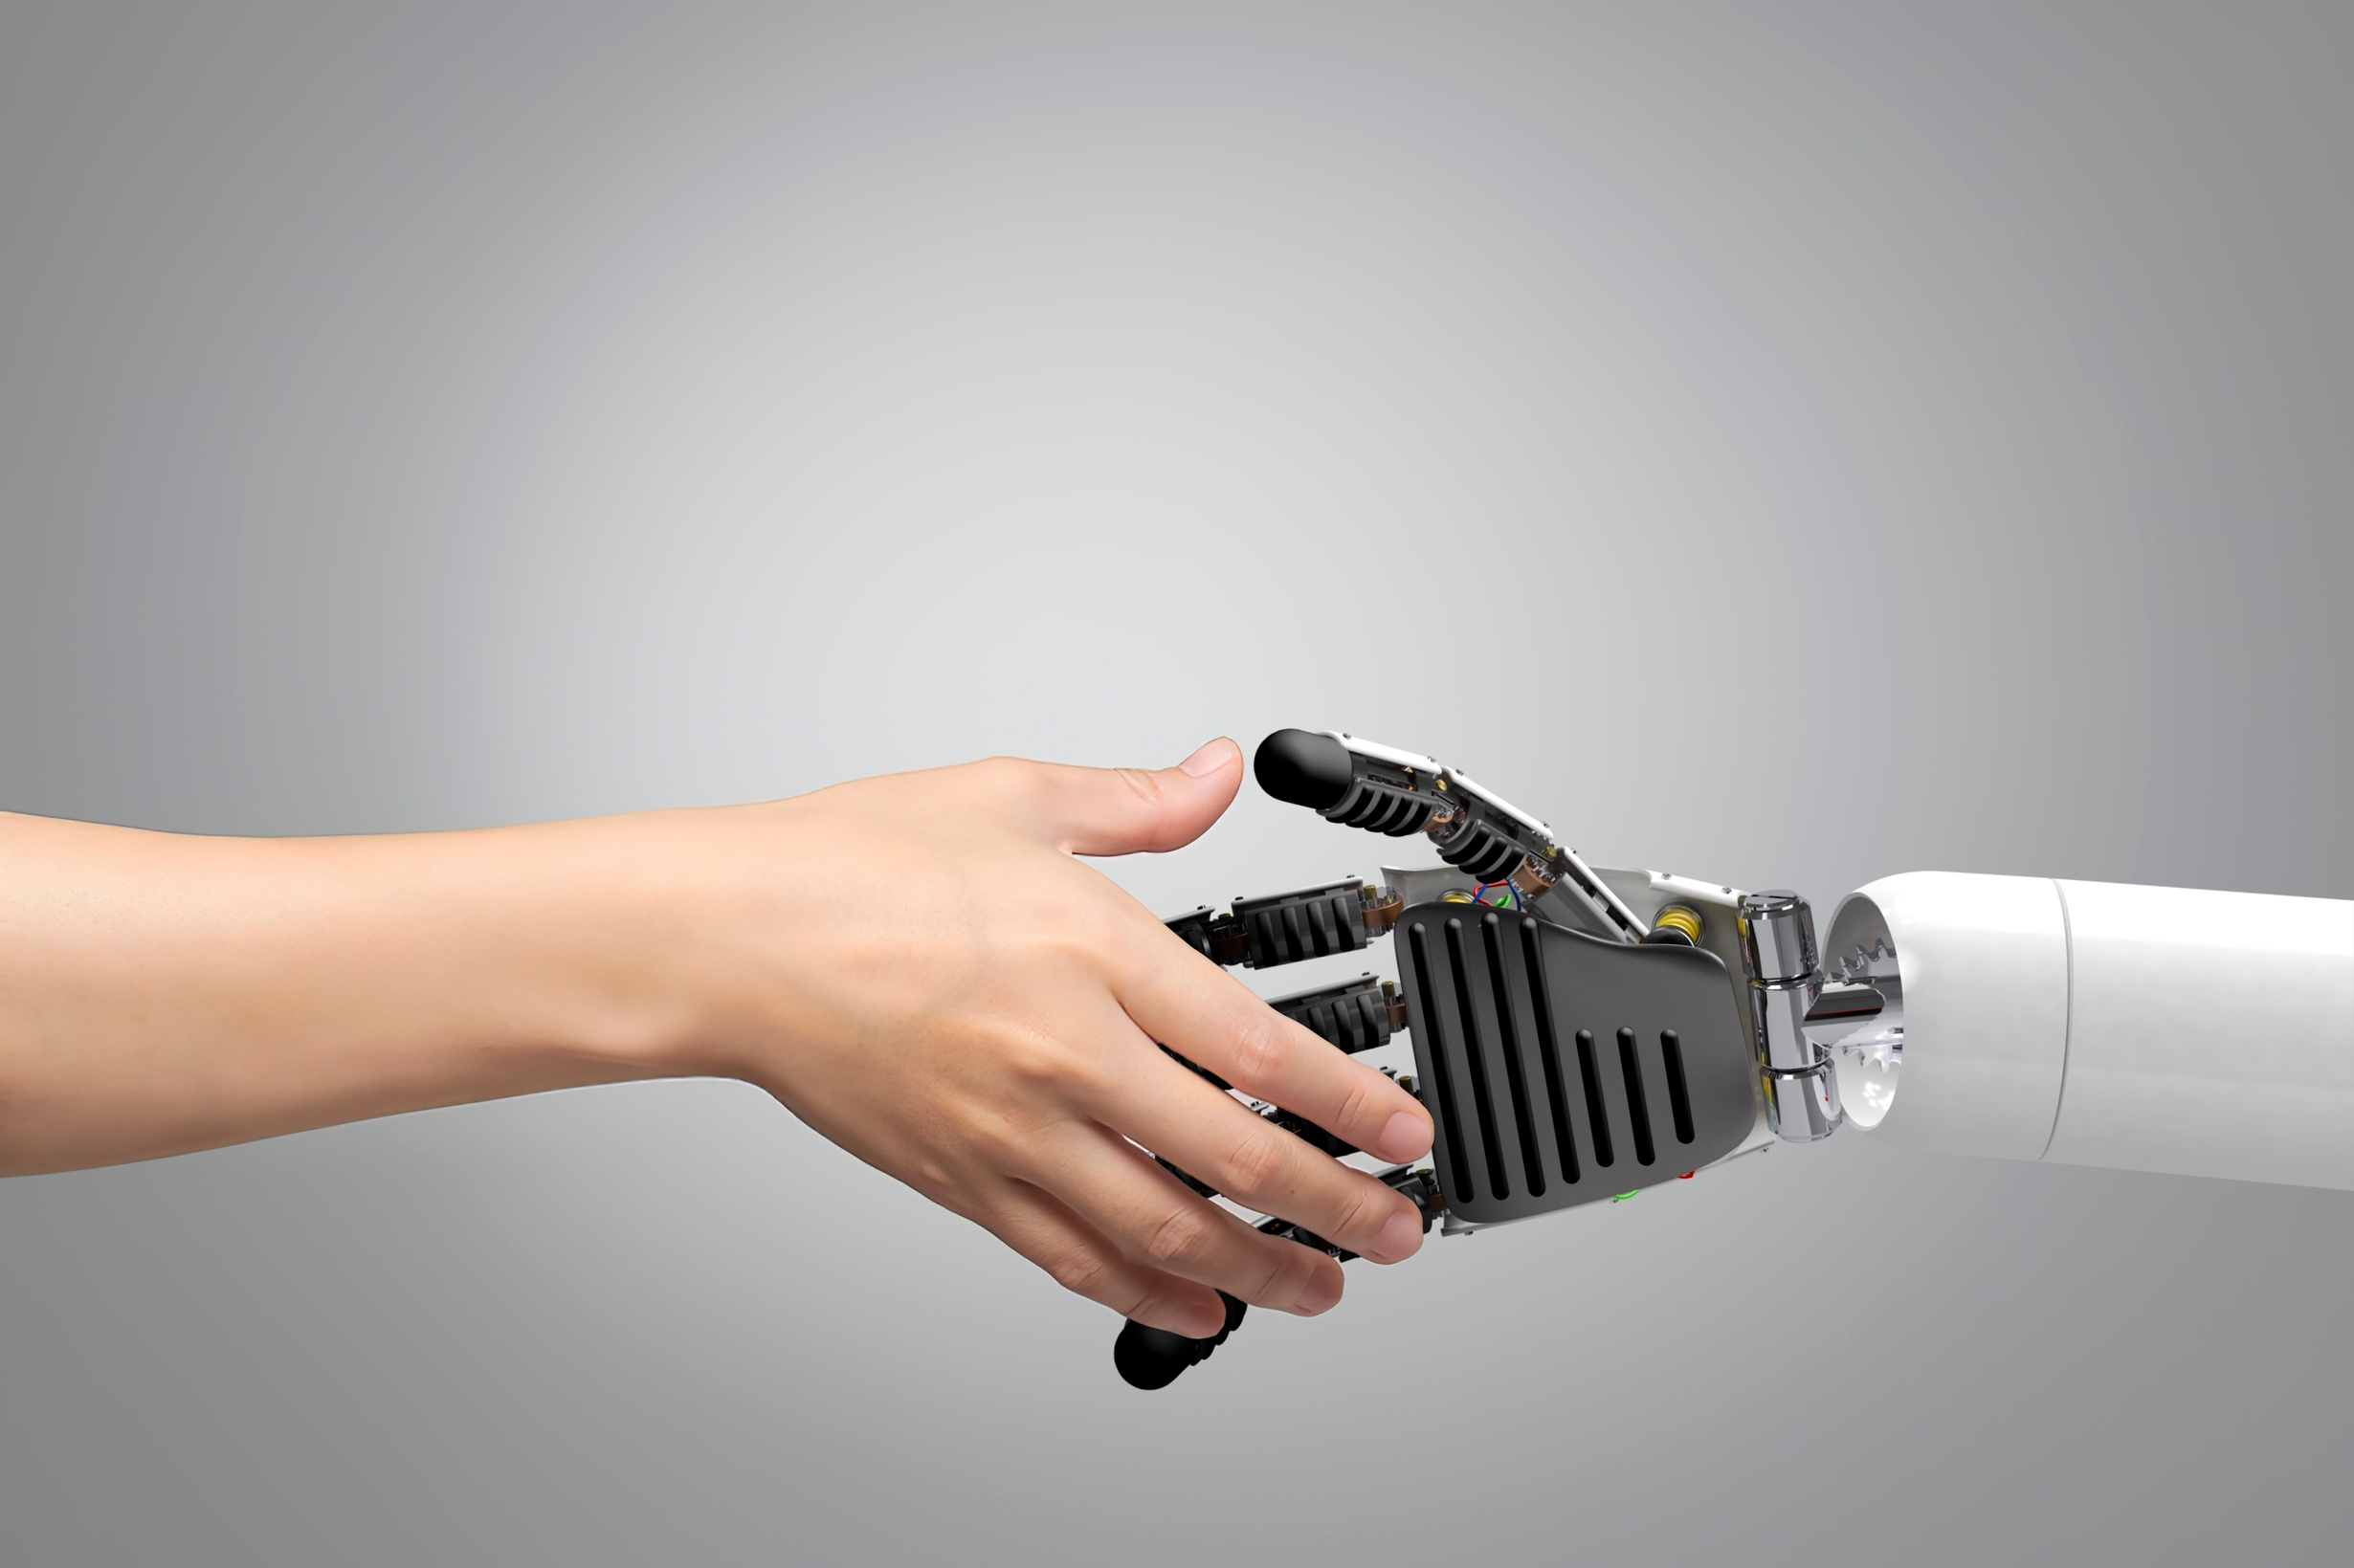
THYNK UNLIMITED.
TECHNOLOGY
AI & Modeling: TensorFlow, Keras
Vision & Landmarks: MediaPipe
Processing: OpenCV
Interface: Streamlit
Future Deployment: Microsoft Azure
Each tool plays a specific role in enabling accurate, fast, and scalable gesture recognition.
STACK

Slide 6

THYNK UNLIMITED.
DATA COLLECTION &
PREPROCESSING
A custom dataset was created due to the limitations of public datasets.
Steps included:
Capturing gestures under consistent lighting
Performing EDA to ensure balanced classes
Applying segmentation to isolate hands
Enhancing data with augmentation
This produced clean, diverse data for robust model training.
Next Slide
MODEL DEVELOPMENT

Slide 7
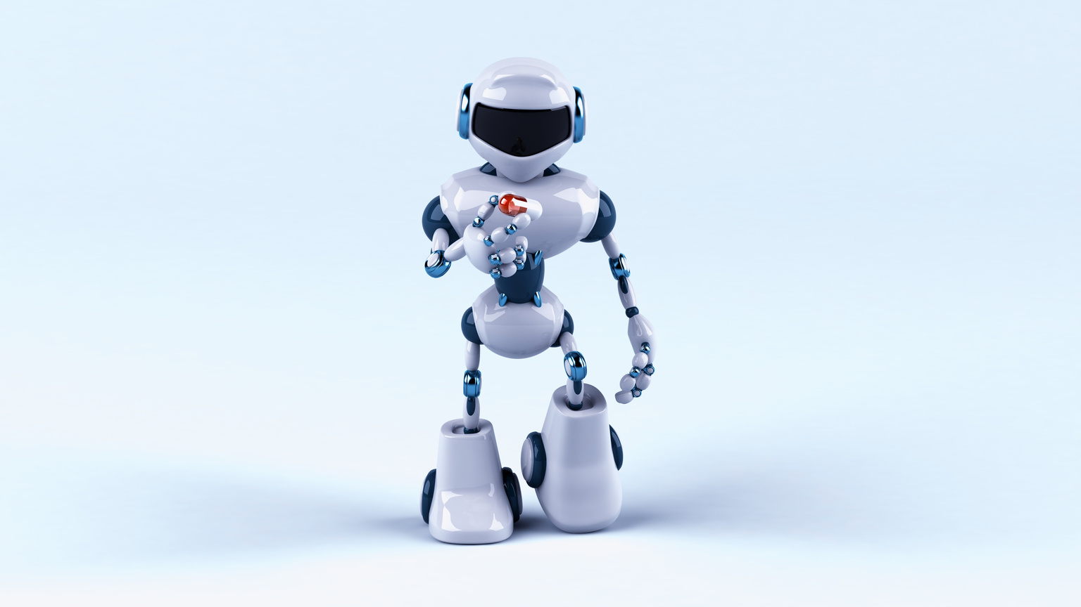
MODEL
THYNK UNLIMITED.
DEVELOPMENT
Hand landmarks (21 points) were extracted for each gesture, forming the model’s input.
A fully connected neural network was built with:
The final model achieved strong accuracy and consistency across different users.
Data Normalization
Dense layers
Dropout
BATCH NORMALIZATION FOR STABLE TRAINING
DENSE LAYERS FOR SPATIAL PATTERN LEARNING
DROPOUT FOR GENERALIZATION

Slide 8
THYNK UNLIMITED.
REAL-TIME
APPLICATION
USING OPENCV AND MEDIAPIPE, THE SYSTEM PROCESSES VIDEO FRAMES CONTINUOUSLY:
Detect hand
Extract landmarks
Run inference through the trained model
Display gesture prediction + confidence percentage
A Streamlit interface makes the system accessible with a single click.
Next Slide

Slide 9

THYNK UNLIMITED.
DEPLOYMENT &
MLOps PLAN
With Azure, the system can support:
Cloud-hosted inference for cross-device access
Automated retraining pipelines
Version control for models and data
Performance monitoring (latency, accuracy, drift)
This ensures long-term reliability and easy scalability.
Next Slide
RESULTS, IMPACT & FUTURE WORK

Slide 10
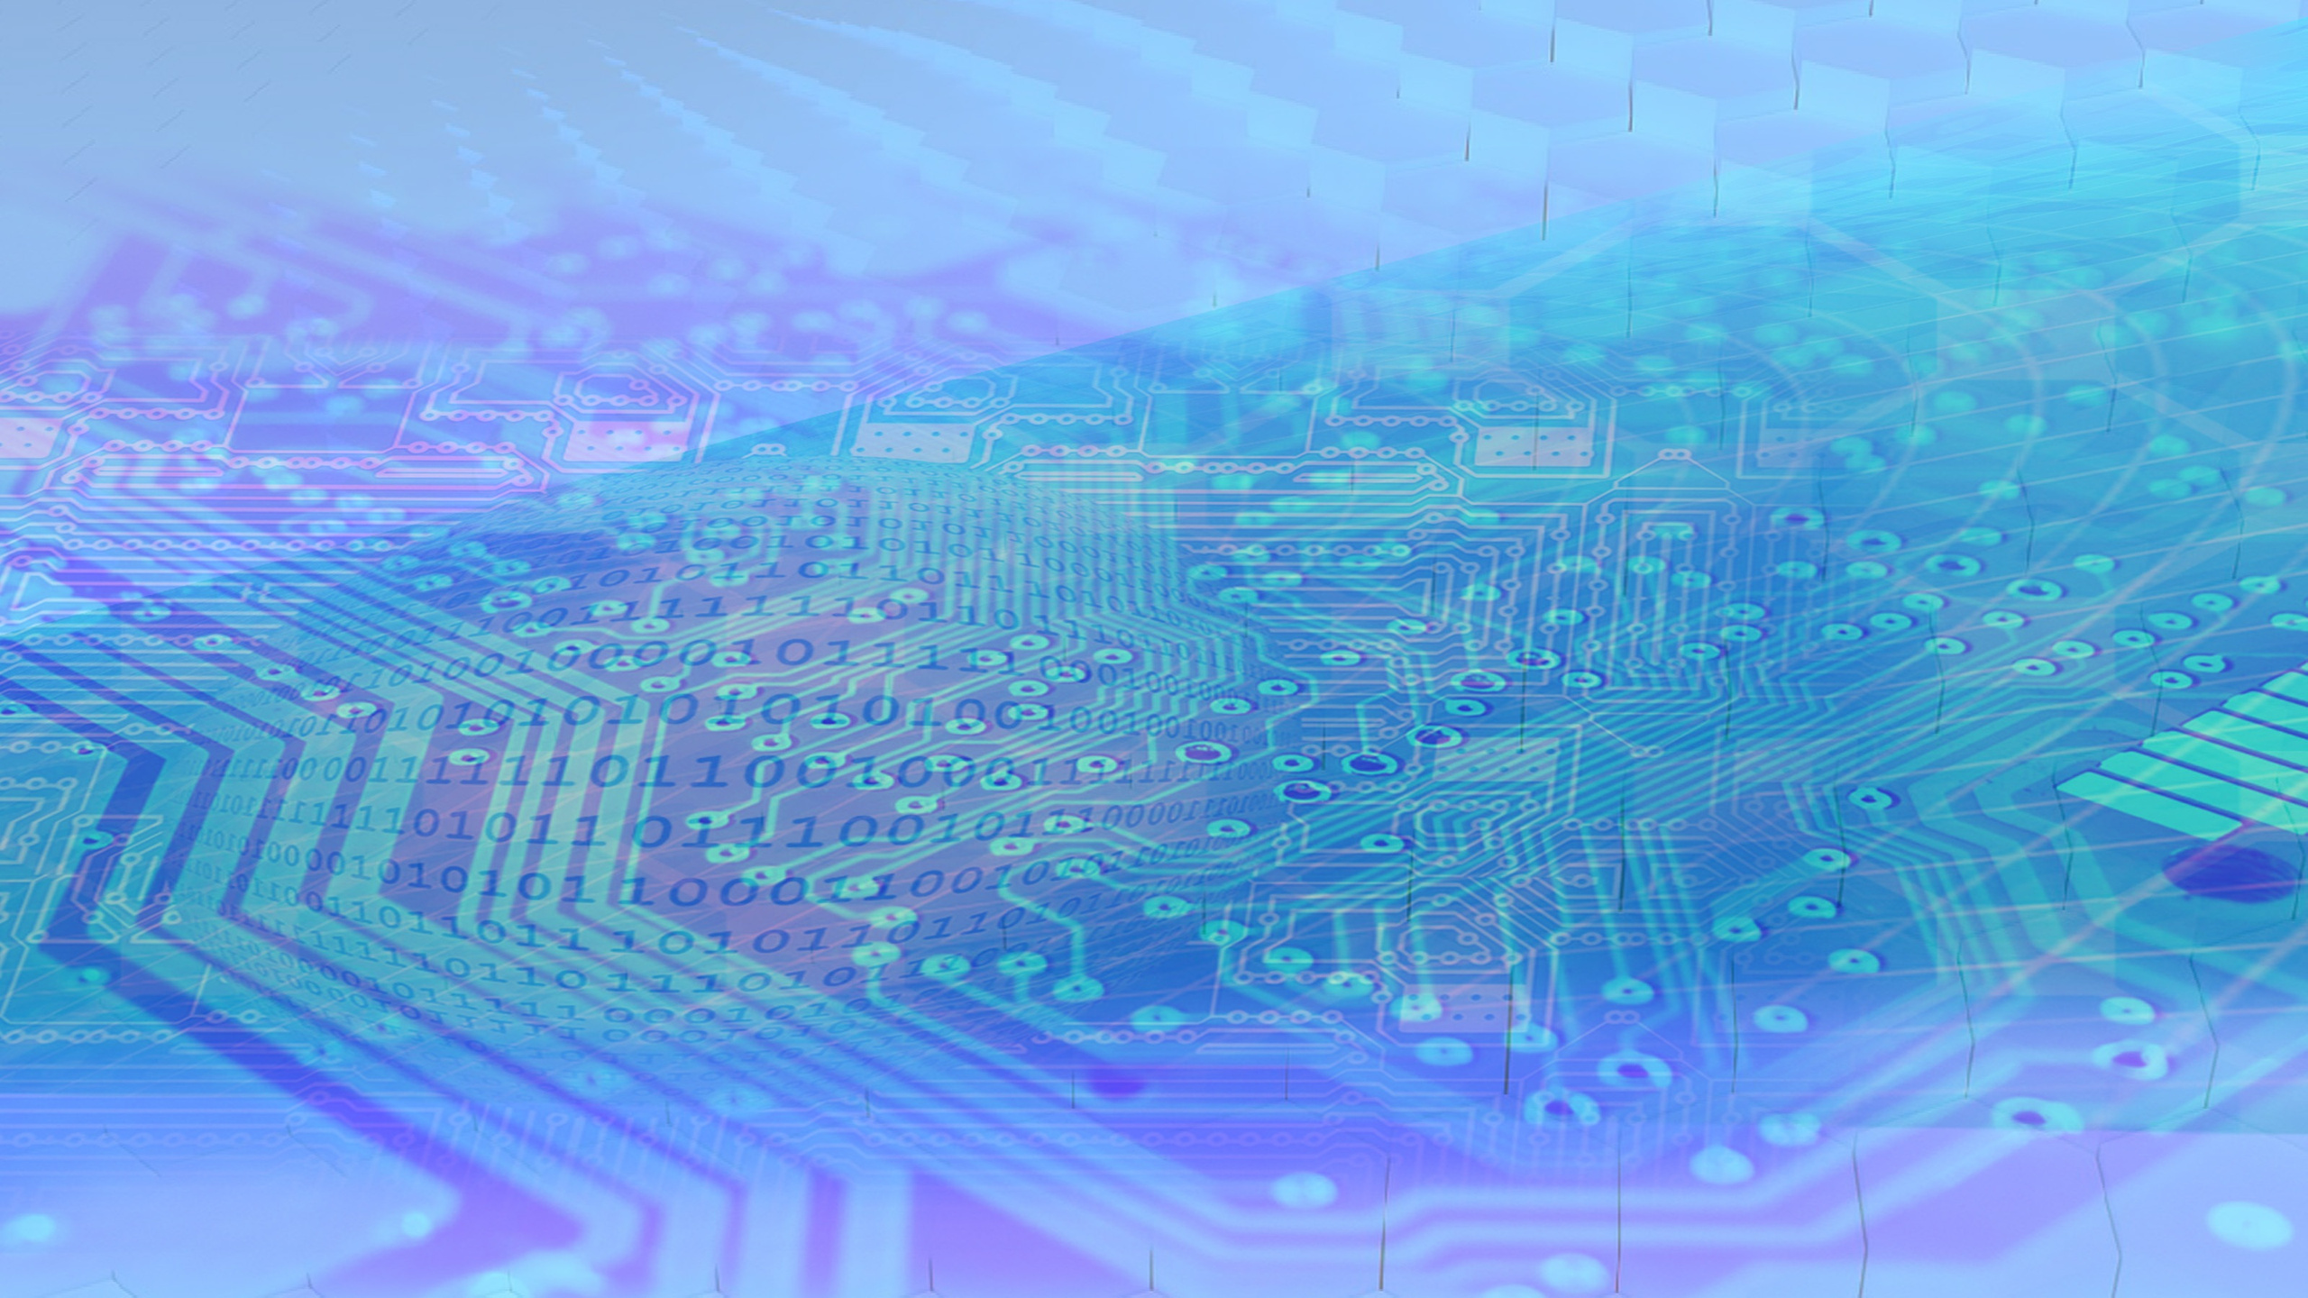
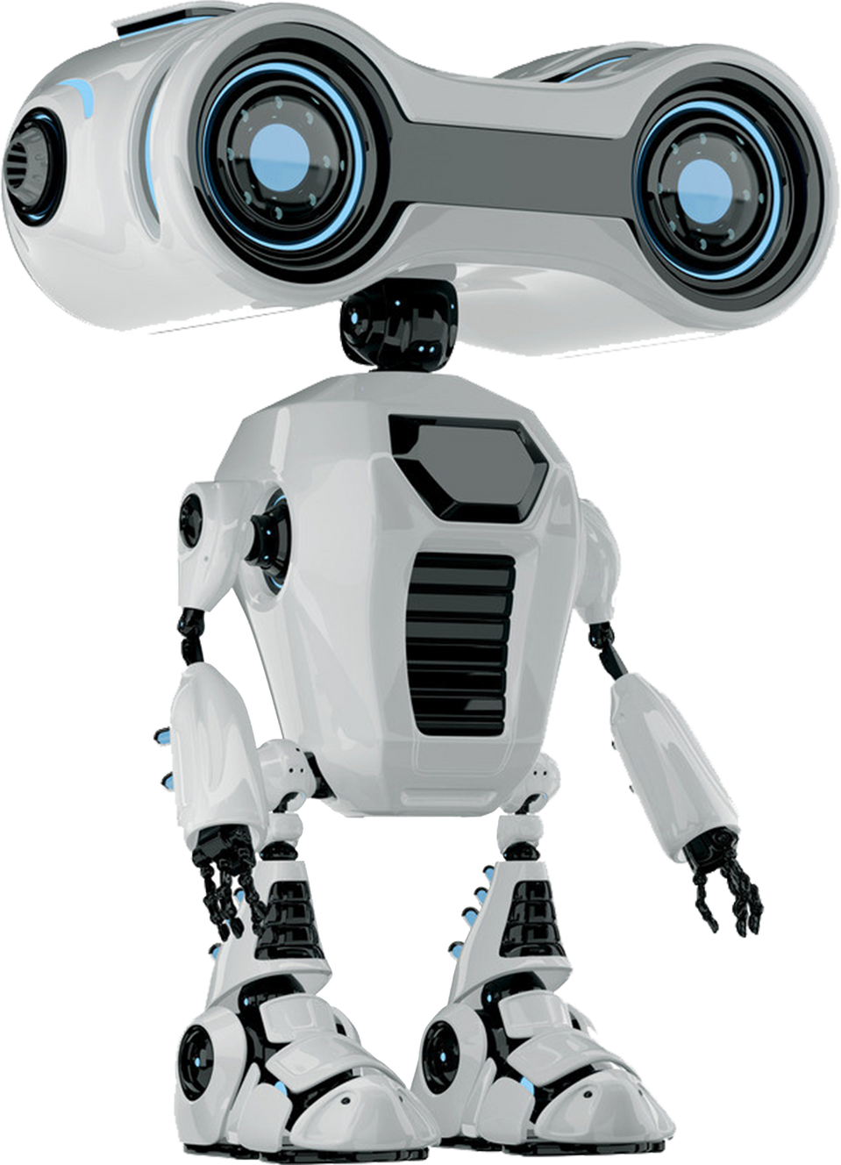
THYNK UNLIMITED.
Gesture-Based
Control System
We extended the gesture-recognition model by building a control program that translates detected gestures into computer actions.
The system maps each gesture to a specific command, allowing users to interact with their device without touching the keyboard or mouse.
Staying ahead in a dynamic threat landscape

Slide 11
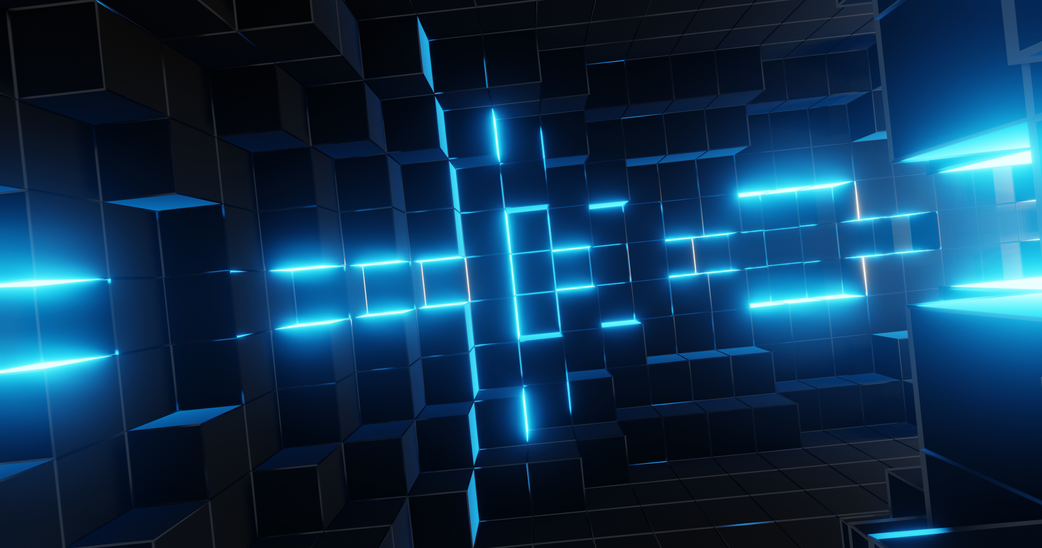
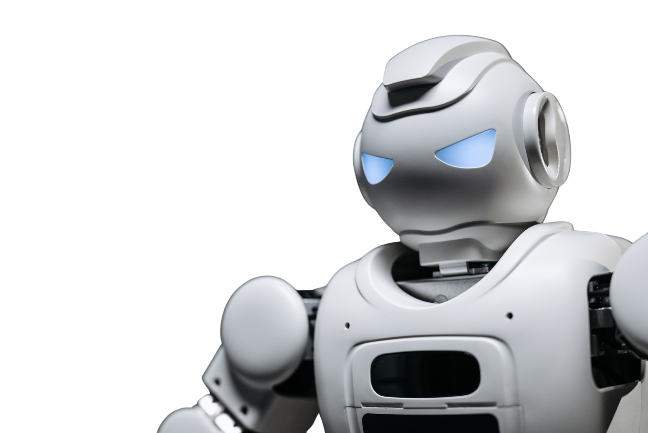
THYNK UNLIMITED.
Gesture-Based
Navigation& Media Control
The program provides a set of intuitive, hands-free controls, including:
Moving the mouse cursor using hand movement
Scrolling vertically through pages or content
Triggering next and previous track actions in media apps like Spotify
Using directional gestures to simulate arrow-key navigation
These features create a smooth, touch-free experience for browsing, media control, and general computer interaction.

Slide 12
RESULTS, IMPACT &
THYNK UNLIMITED.
FUTURE WORK
Results:
Smooth real-time gesture recognition
Accurate classification across multiple static gestures
Fully functional demo interface
Future Enhancements:
Dynamic gesture recognition
Larger gesture vocabulary
Mobile + IoT deployment
Integration with smart devices and AR/VR
THIS PROJECT DEMONSTRATES HOW AI CAN CREATE MORE INTUITIVE, ACCESSIBLE, AND HUMAN-CENTERED INTERACTION EXPERIENCES.

Slide 13
Thank
THYNK UNLIMITED.
YOU

